Slide 1
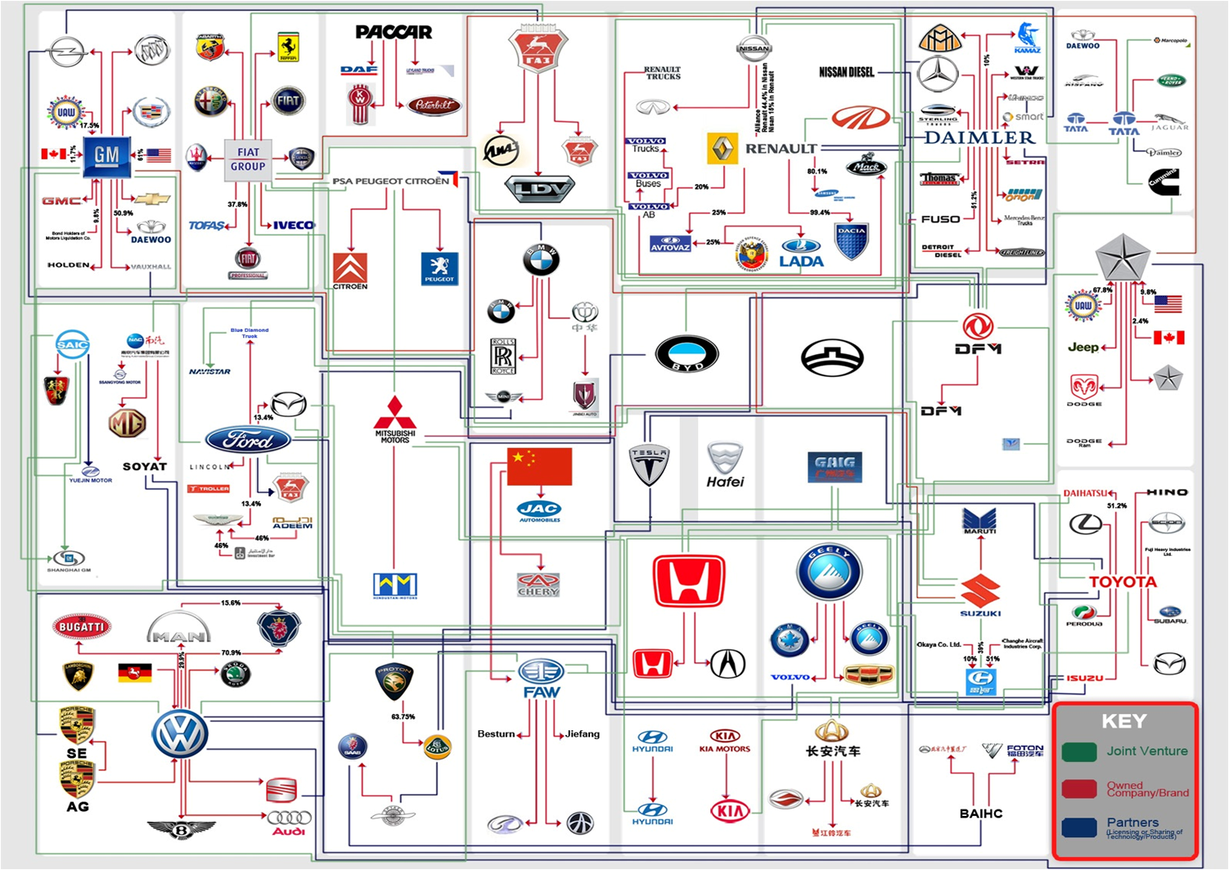
and
Top 5
Auto Makers
Automotive Family Tree
Sergio Silva
15 February 2012

Slide 2
Did you know?
Every major auto maker has ties to their competition, whether through ownership and/or technology sharing.

Slide 3
Overview:
The automotive family tree
Top 5 auto makers based on sales volume:
  Company
  2011 total sales and trend
  Subsidiaries
Recap
Conclusion
Questions

Slide 4
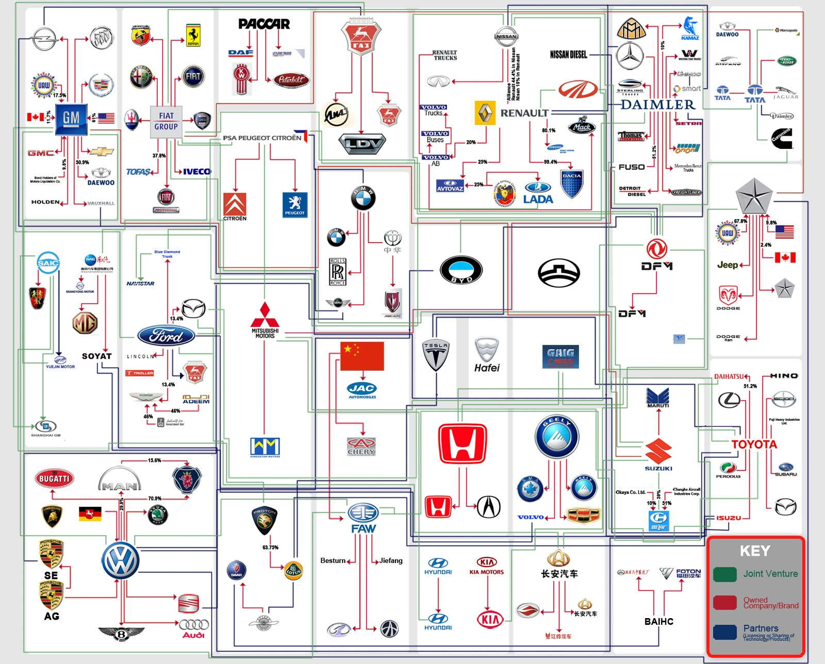
Automotive Family Tree

Slide 5
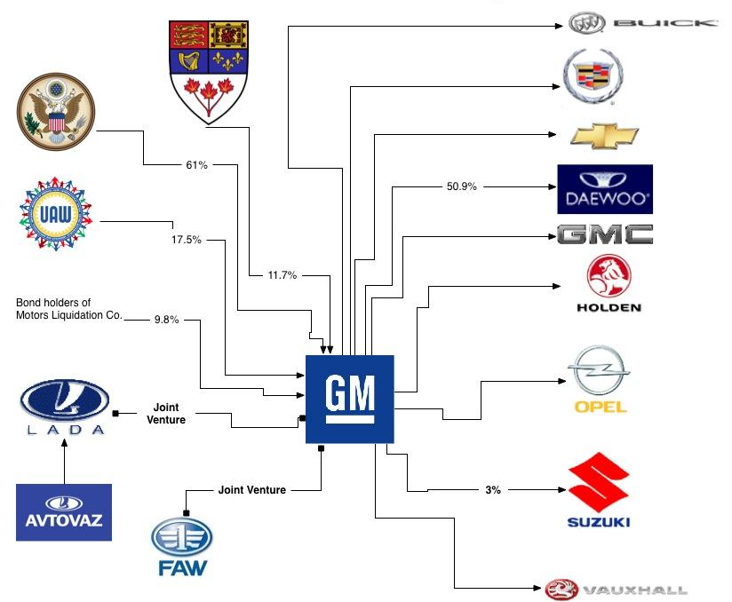
#1 - GENERAL MOTORS
2011 Total Sales: 9.03M Vehicles (25% of which in China)
(+7.6% from 2010)

Slide 6
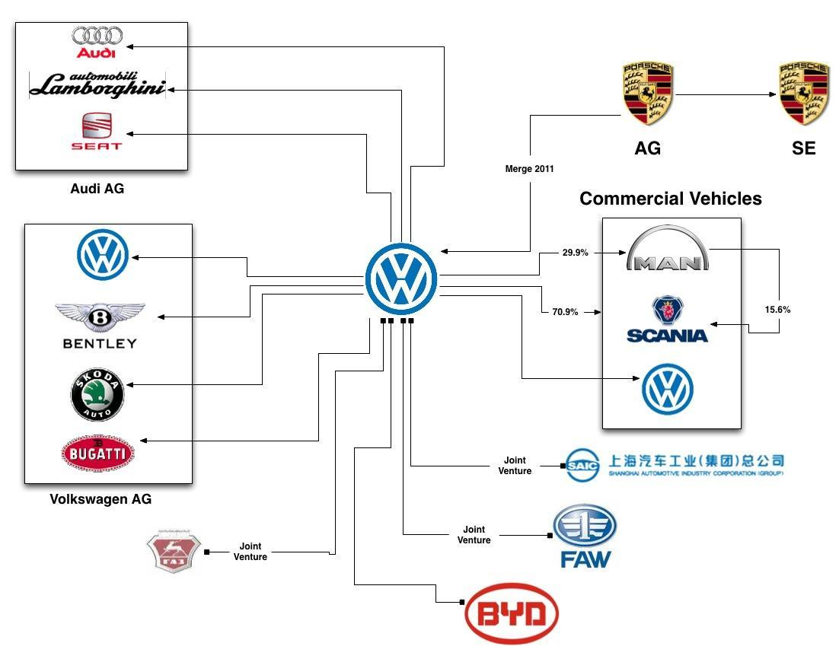
#2 – VOLKSWAGEN AG:
2011 Total Sales: 8.16M Vehicles
(+14.3% from 2010)

Slide 7
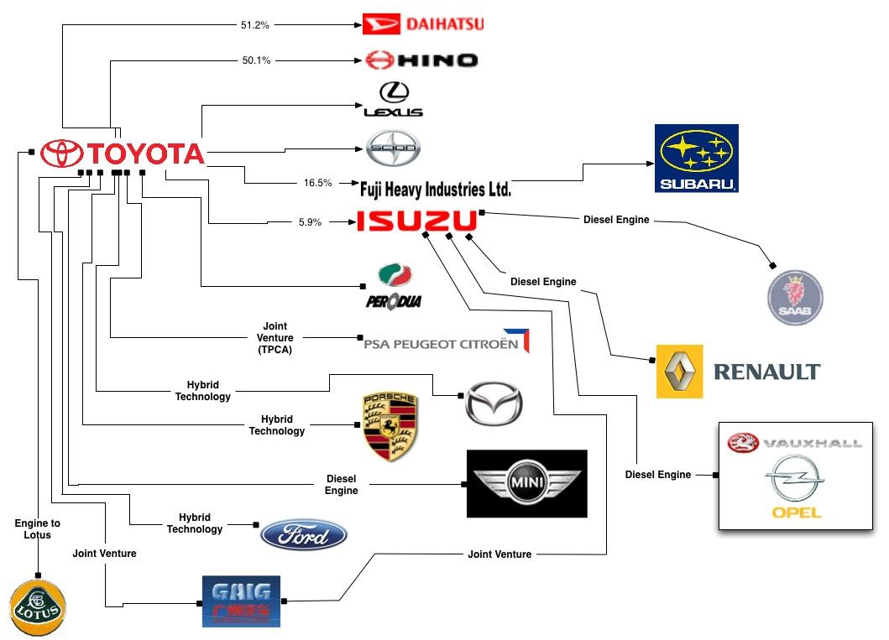
#3 – TOYOTA
2011 Total Sales: 7.9M Vehicles
(-7.6% from 2010)

Slide 8
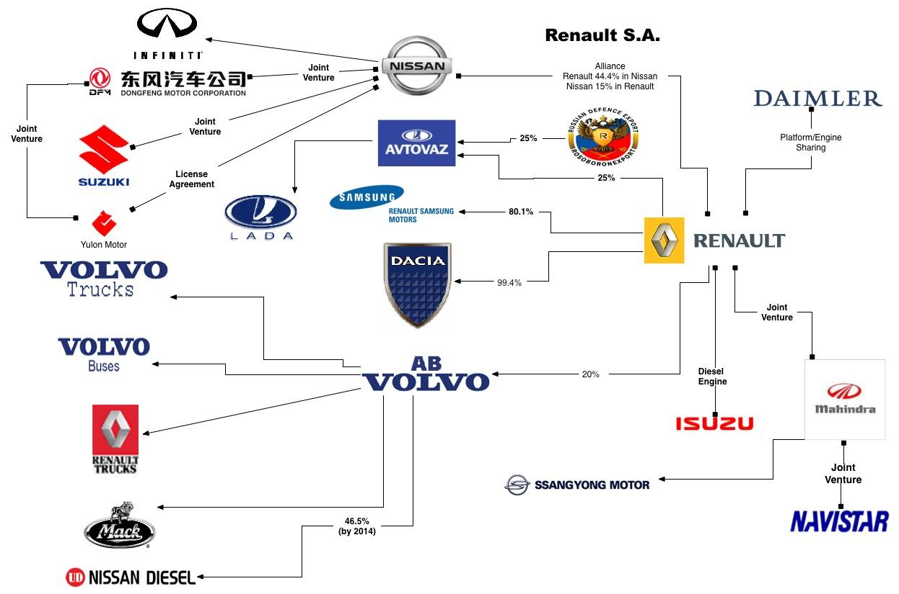
#4 – RENAULT -NISSAN
2011 Total Sales: 7.39M Vehicles
(+10.3% from 2010)

Slide 9
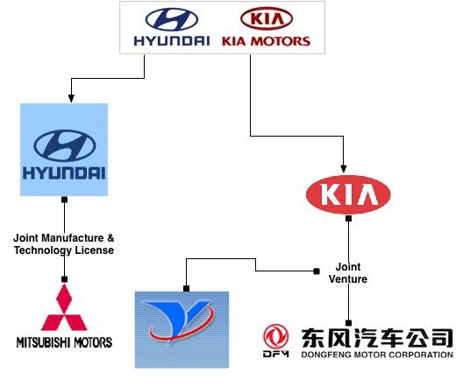
#5 – HYUNDAI-KIA
2011 Total Sales: 6.59M Vehicles
(+12.4% from 2010)

Slide 10
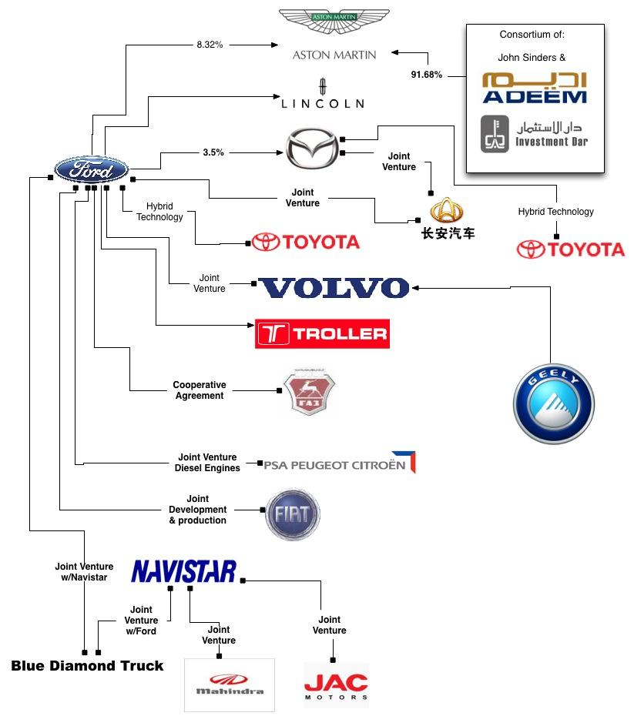
FORD
2011 Total Sales: 5.4M Vehicles

Slide 11
RECAP:
There is a high level of collaboration and technology sharing between the major auto makers.

Slide 12
conclusion:
The top 5 auto makers have direct tires to their competitors, resulting in more efficient, cost-effective development of new vehicle technologies.

Slide 13
Questions?

Slide 14
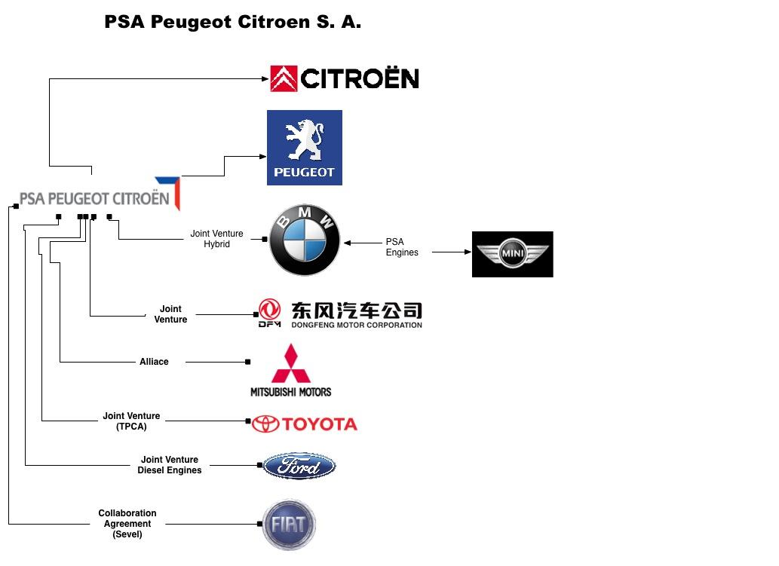
PSA Peugeot Citroen, SA
2011 Total Sales: 3.54M Vehicles (-1.5% from 2010)

Slide 15
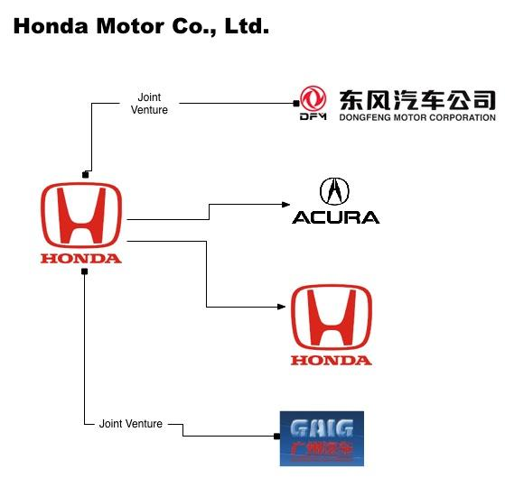
HONDA
2011 Total Sales: 3.09M Vehicles (-13% from 2010)

Slide 16
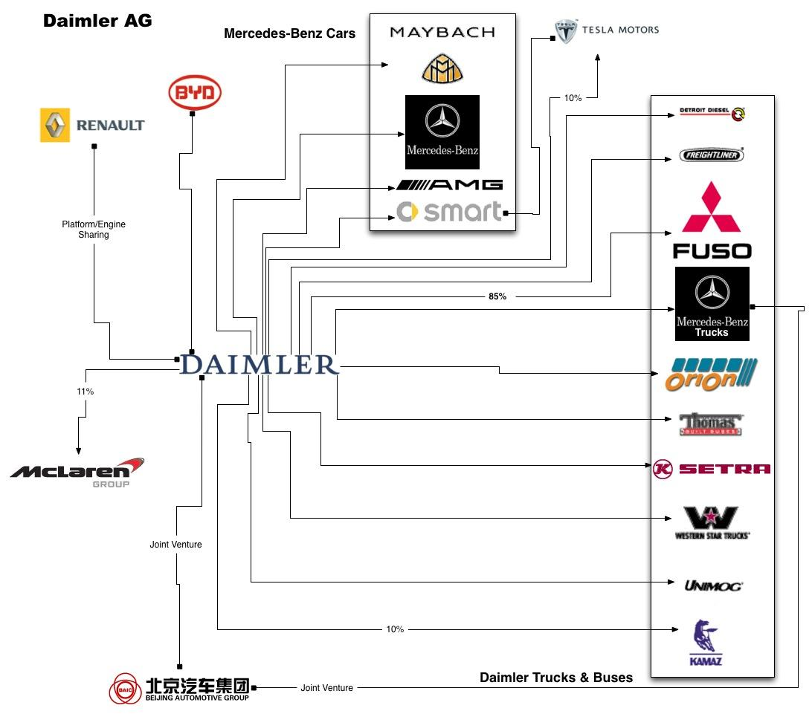
DAIMLER
2011 Total Sales: 2.11M Vehicles (+11% from 2010)

Slide 17
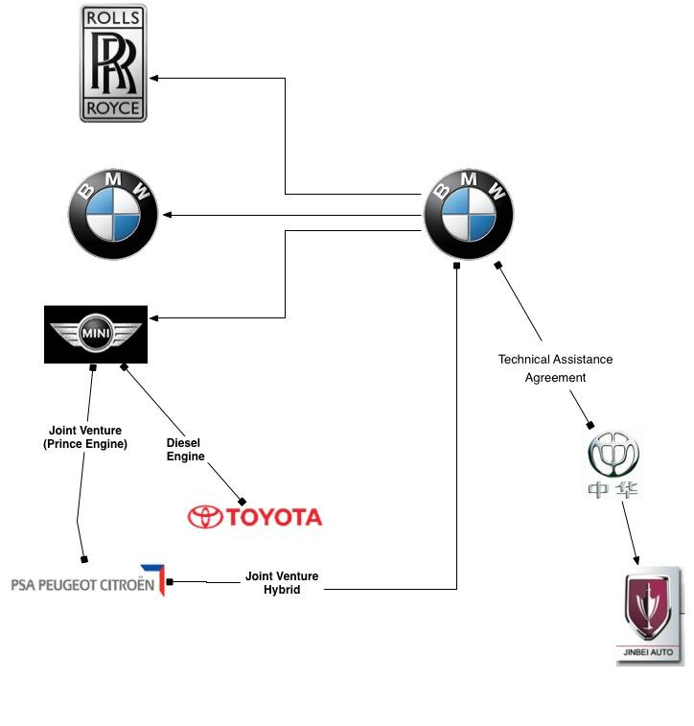
BMW AG
2011 Total Sales: 1.66M Vehicles (+14.2% from 2010)

Slide 18
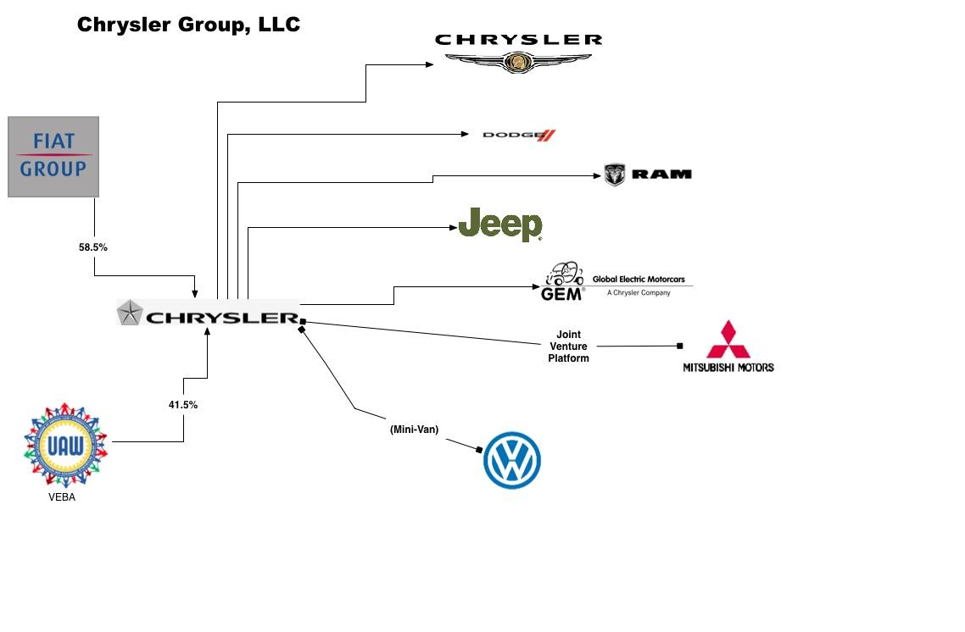

Slide 19
